Slide 1

Does LA city employee compensation growth align with housing price growth?
Team
Susan Quiros
Elijah Abuel
Harika Peddiraju
Mohan Panga

Slide 2
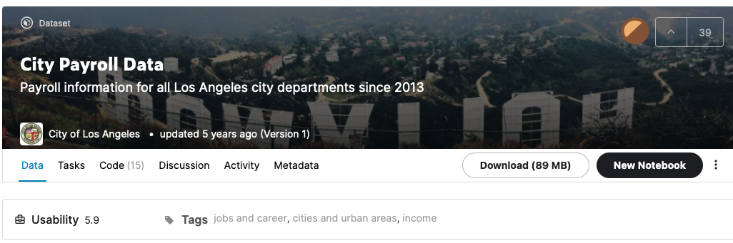
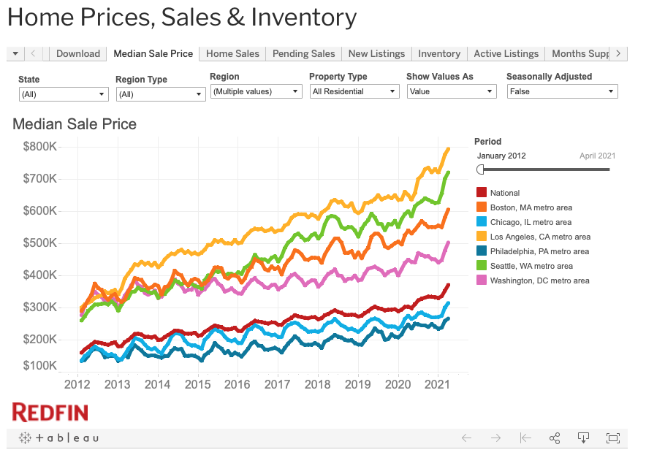
Data Sets
Kaggle: Los Angeles Public Sector Salaries
https://www.kaggle.com/cityofLA/city-payroll-data
Data from 2013 to 2016
Redfin: Housing Prices in LA
https://www.redfin.com/news/data-center/
2013 to 2021

Slide 3
Data Analysis Workflow
Data Cleaning
Selecting Departments
Analyzing
Top 4
Job Class Titles
Housing Price
vs
Salary Growth
58 total departments
Selected:
Fire
Police
Recreation & Parks
Water & Power
~ 100-325 job titles per department
Analyzed 2013, 2014, 2015
base pay
total payments
benefit cost
% increase in housing price vs. base pay for selected job titles
Drop NA & missing values
Data Typecasting

Slide 4
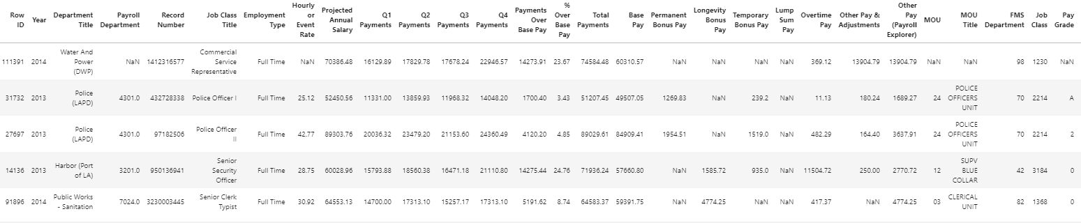
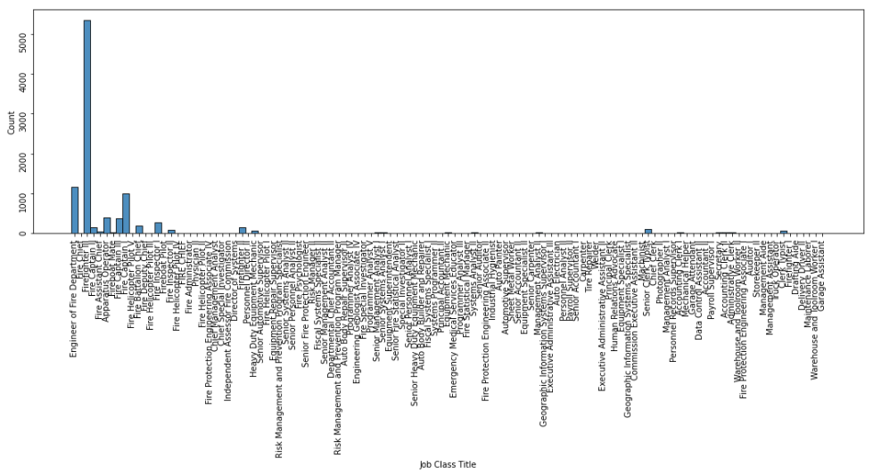
Data Overview
285008 records ✕ 36 fields
e.g. Job Class Titles in Fire Department

Slide 5
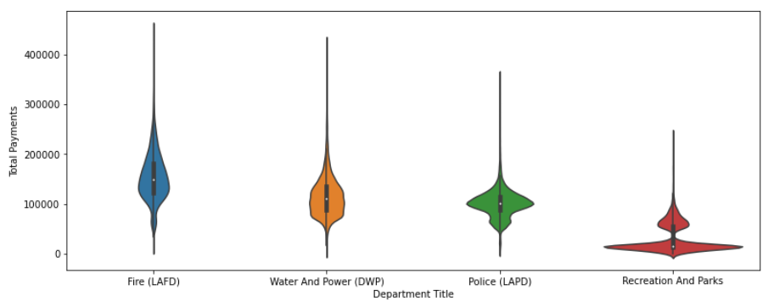
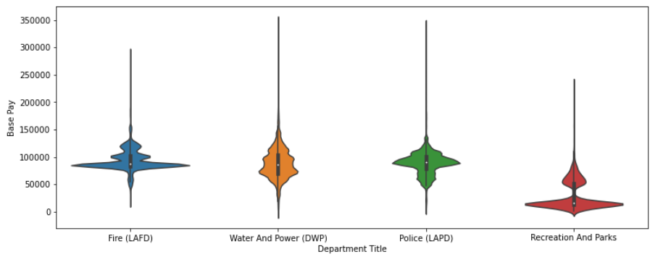
Salary Distribution
Selected top 4 job class titles based on number of records
Fire Department has higher average total payments
Recreation and Parks has lower pay than other departments

Slide 6
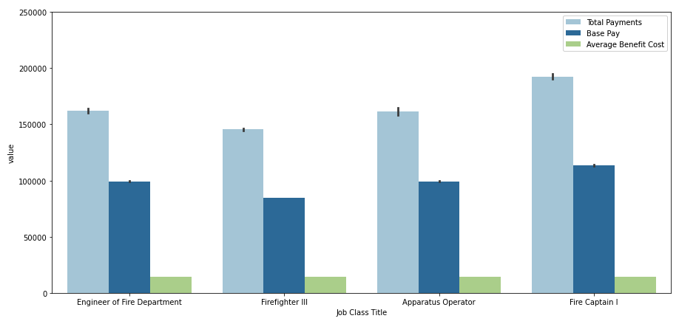
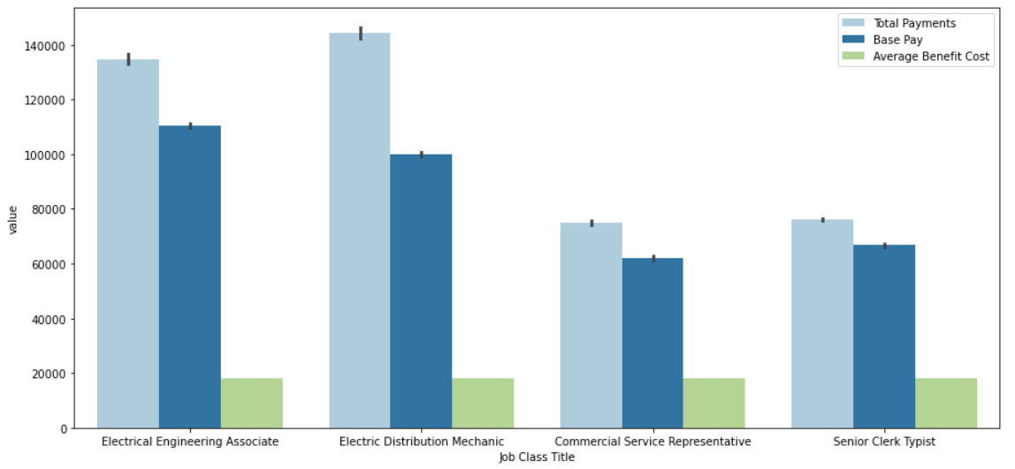
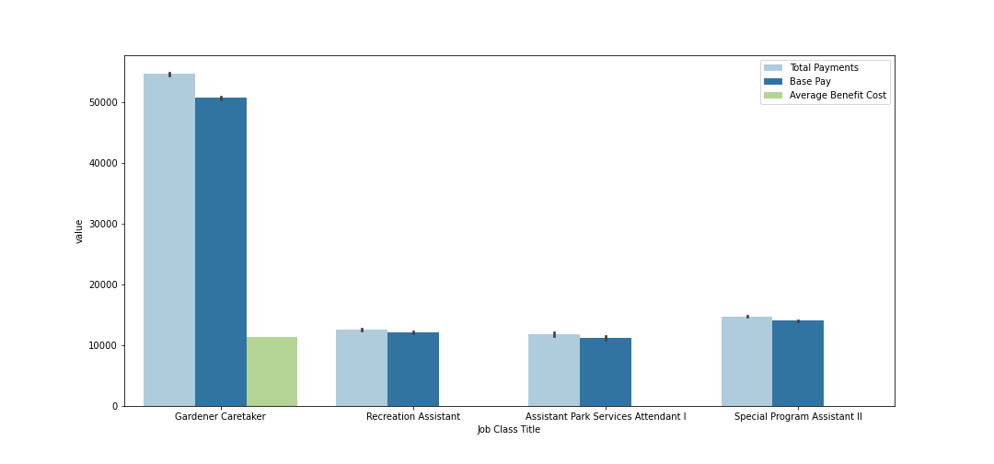
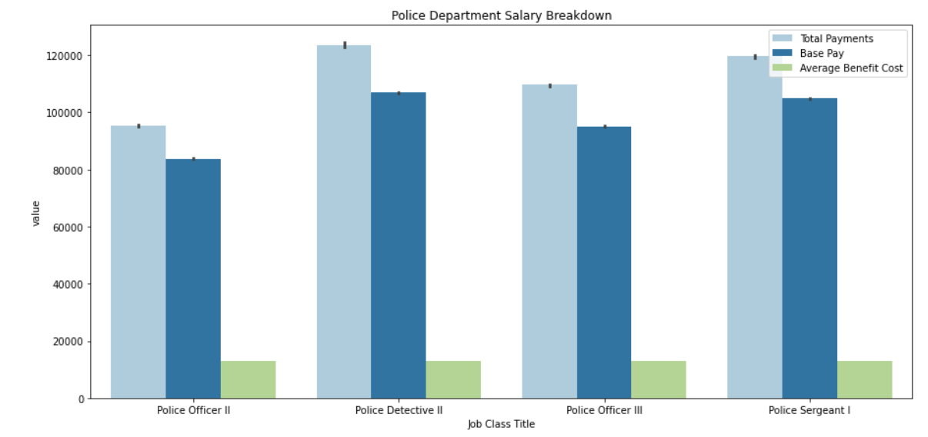
Salary Breakdown Overview
Fire Department
Recreation & Parks
Police
Water & Power

Slide 7
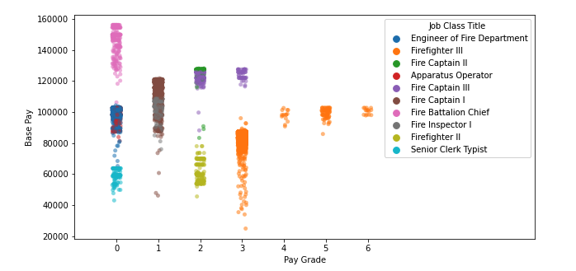
Pay Grade

Slide 8
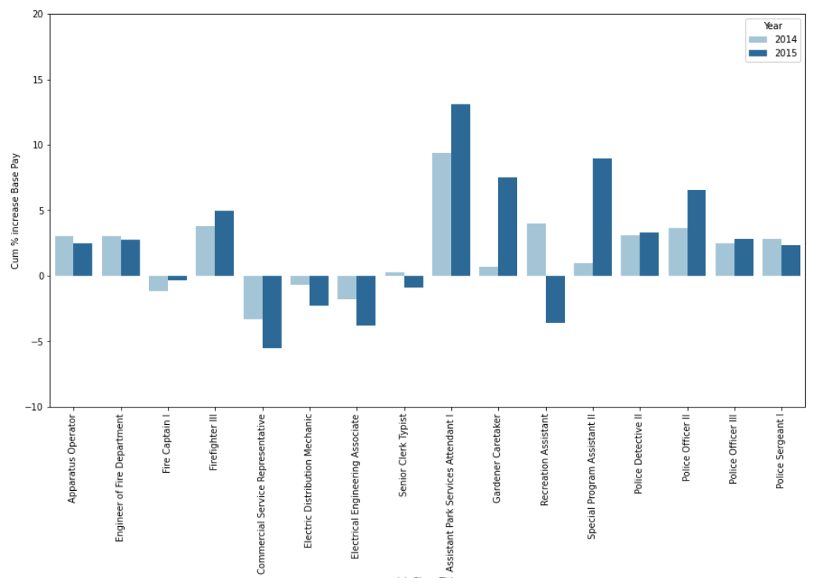
Salary Growth
Fire
Water & Power
Recreation & Parks
Police

Slide 9
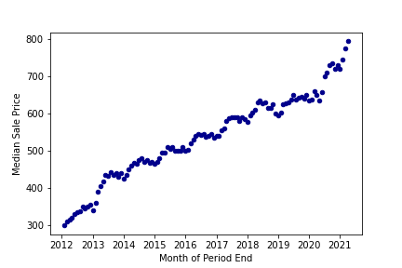
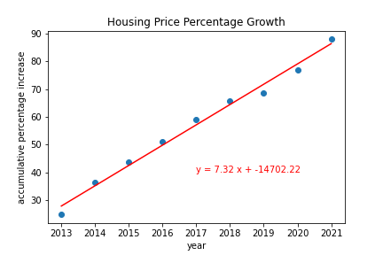
Housing
~ 7% increase in median home price YoY

Slide 10
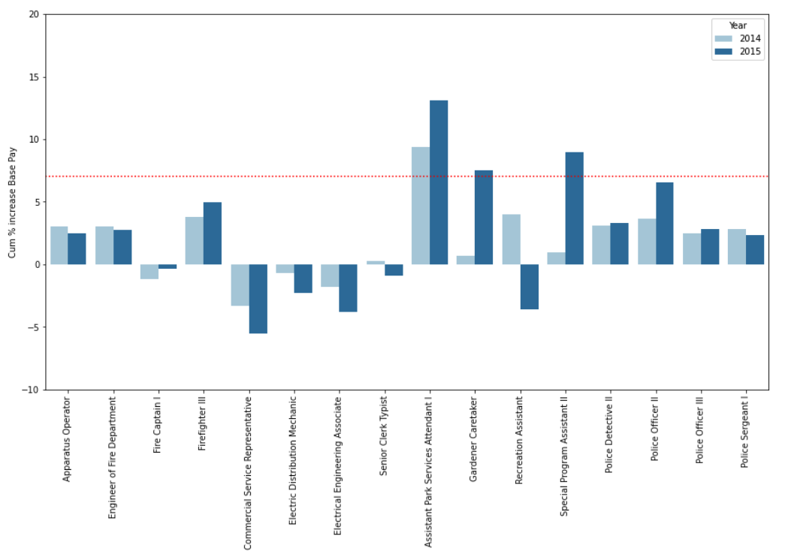
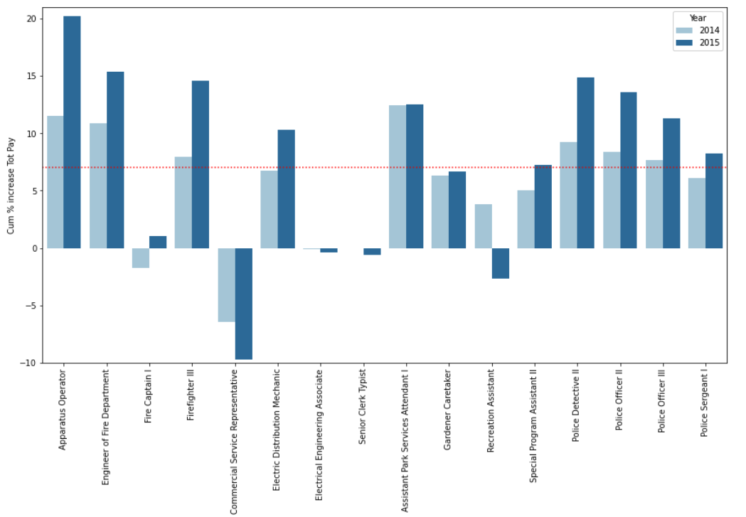
Housing vs Salary Growth
Fire
Water & Power
Recreation & Parks
Police
Fire
Water & Power
Recreation & Parks
Police

Slide 11
Conclusion
Through our analysis, we can conclude that:
Out of the 16 different job class titles, only 2 of them are aligned with the housing percentage growth respect to the base payment. However, we get a different scenario when comparing the housing growth with the total payments, here a total of 9 class job titles show that are aligned with the same tendency and this effect can be explained by the overtime payments and bonuses that are added to the base pay through the fiscal year. Additionally, another interesting point that stands up from our analysis is that the water and power department has an anomaly in how the salaries behave through the years, we conducted a further exploration that has evidenced a decline in average base pay, the violin/strip plot and the box and whisker plots in slide 13 shows how the inter quartile range has a downward trend implying the increasing population of employees with lower base pay . this signifies the increasing trend in more entry level employees vs mid senior or senior employees.

Slide 12
Questions ?

Slide 13
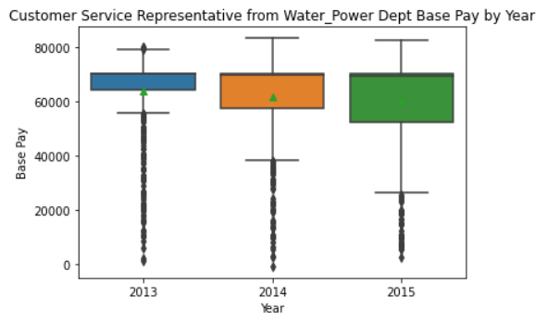
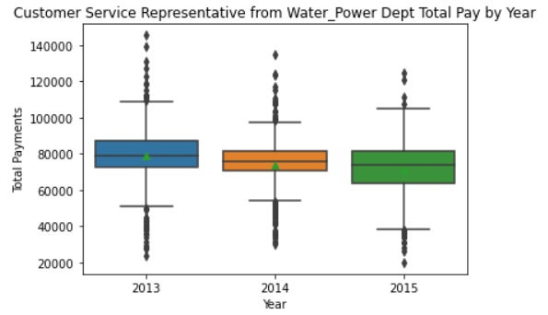
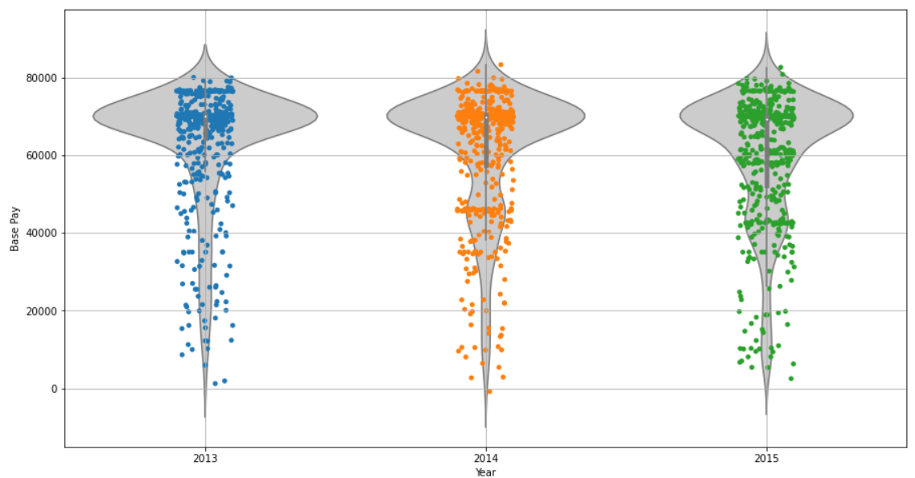
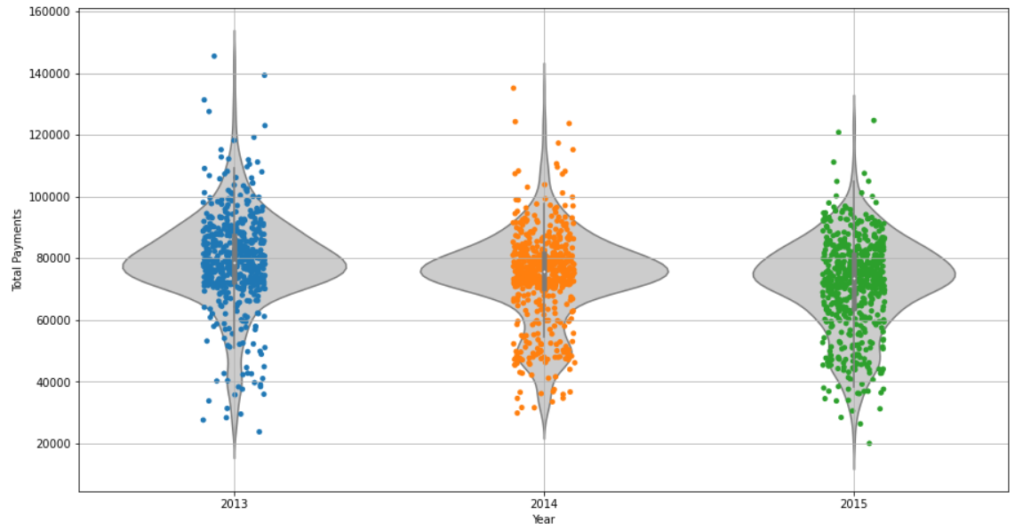
Back up

Slide 14
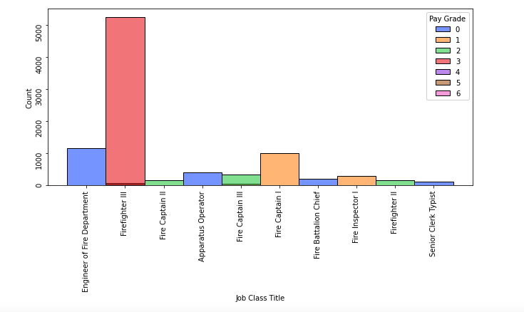
Job Titles: Filtered

Slide 15
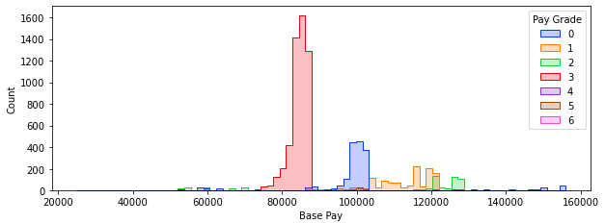
Base Pay based on Pay Grade

Slide 16
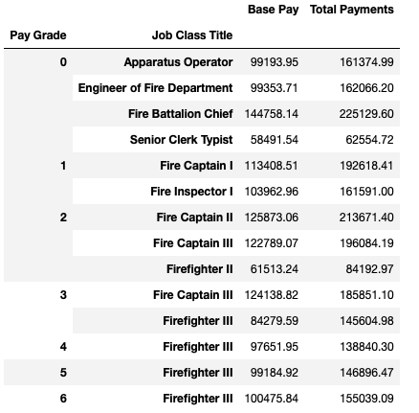
Base Pay per Job Class

Slide 17
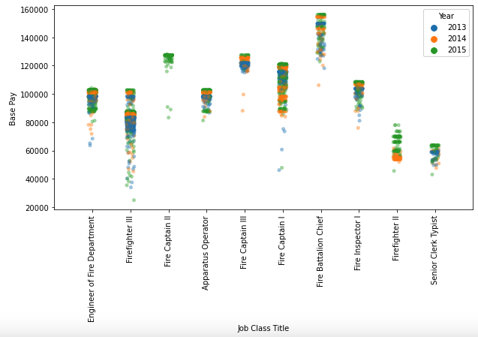
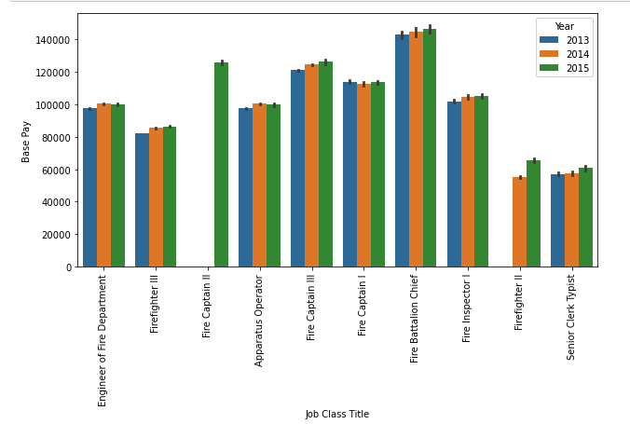
Yearly Data

Slide 18
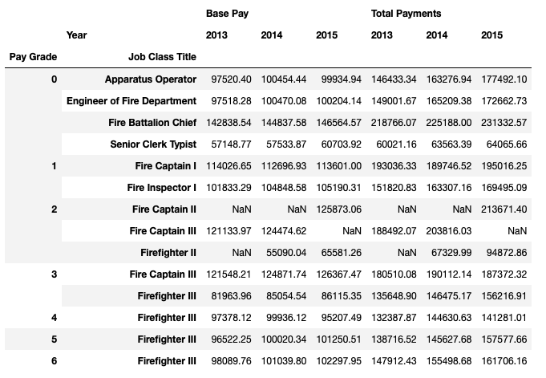
Data Summary

Slide 19

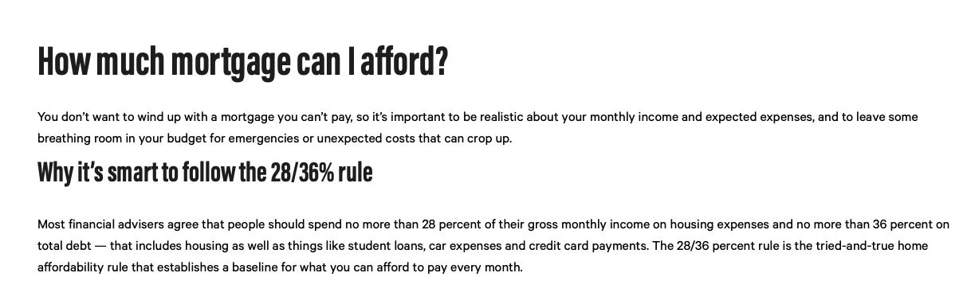
House affordability

